Slide 1
Unlocking the Hidden Costs of Welding Executive Seminar

Slide 2
Introductions
In Case of Emergency
Phone on Vibrate. Please leave room if necessary.
Getting Started…
What do you do for your company?
What do you hope to gain from this seminar?
Do you have your gas and wire purchases for the last six months?
Divide the gas used in SCF by the lbs of wire used
Write down that number and we’ll come back to it shortly
Unlocking the Hidden Cost of Welding

Slide 3
What Are We Hearing from U.S. Manufacturing Companies
Most Important Issues:
Cost Reduction + Productivity Initiatives
Employee Training
New Technology in Operations
Equipment Service for Advanced Fabrication
Are these common needs or wants for your welding operation?
Sources: 1. 2013 ITW + Hypertherm End User Surveys
2. Airgas Account Feedback
Unlocking the Hidden Cost of Welding

Slide 4

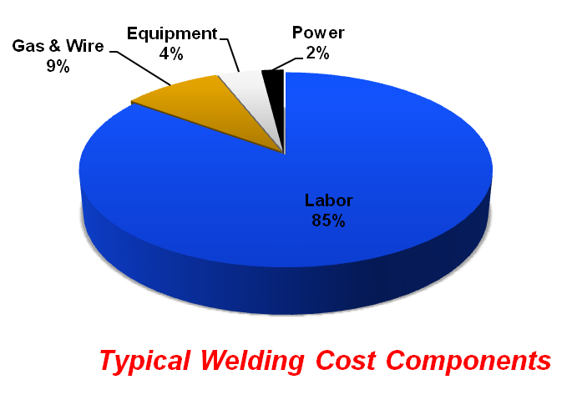
Cost Reduction & Productivity Case Study for Welding
Price of Gas, Wire & Equipment
Bain & Company
A Fresh Look at Procurement Jan 2012
Very real need to reduce costs
Focus on consumption & mix
Total Cost of Ownership (TCOs)
Unlocking the Hidden Cost of Welding
Notes:
Today we’ll spend most of our time on the first issue – Cost Reduction & Productivity in Welding
Introduce pie chart…yawn!! How many times have you seen this chart
Where is the real money?? Obviously in Labor. I think most companies know that is the case but they have a harder time accessing so they hit the EASY button on price of Gas, Wire and Equip
Bain – consulting company did an executive survey
Our approach is to help all of you uncover many of these issues in your welding operation so you can access consumption and TCO’s

Slide 5
How Do You Unlock Your Hidden Costs?
Blood Test: What are your numbers and how do they compare to the national average?
How do you measure the health of you welding system?
“We’ve always done it this way.”
Is good…good enough?
Is bigger always better?
Where have all the welders gone?
Do you have GAS?
Unlocking the Hidden Cost of Welding
Notes:
4

Slide 6
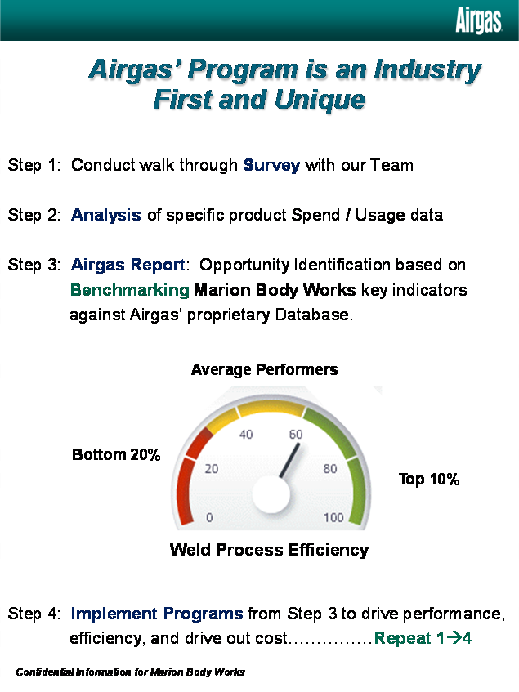
Getting a Perspective on Welding Costs Is Good…Good Enough?
Efficiency Analysis
Database of common welding metrics from manufacturers across the U.S.
The Average Customer Uses:
Metric | Bottom 20% | Average | Top 20%
Shielding Gas per lb. of Wire | 22.8 | 11.8 | 6.1
Ideal Gas per lb. of Wire |  | 4.0
Average “Arc On” Time | 2 min | 9 min | 17 min
Lb. of Wire per Contact Tip | 2.7 | 14.3 | 25.5
1.9x’s more
1.8x’s more
Unlocking the Hidden Cost of Welding

Slide 7
We’ve Always Done It This Way… Industry Observations
“Most welding operations are 20 to 30 years behind their sister machining operations.”
“Productivity of the average welding operation can be improved by 20 to 40% with little or no capital investment.”
Unlocking the Hidden Cost of Welding
Source: Barckhoff & Associates
Notes:
6

Slide 8
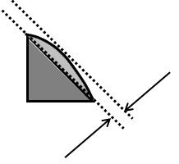
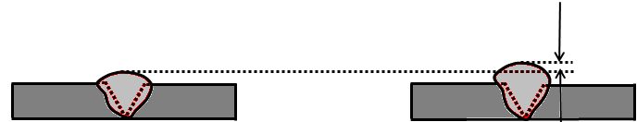
Weld Volume: Is Big Always Better?
10 to 35%
Unlocking the Hidden Cost of Welding
Notes:
7

Slide 9
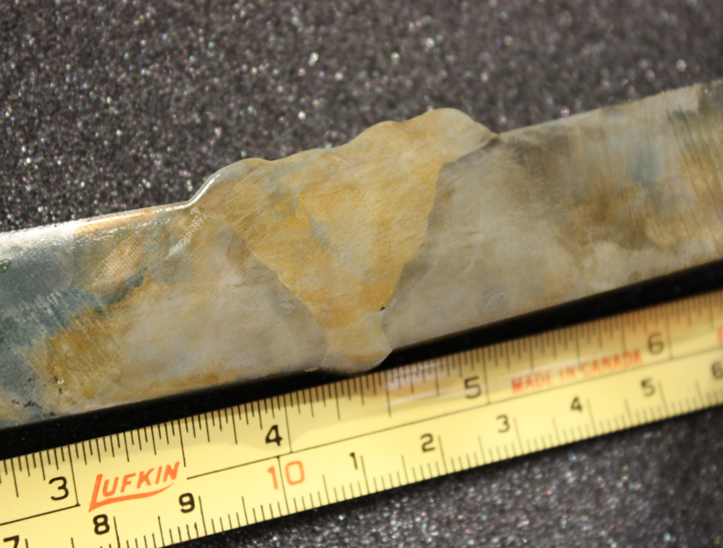
Stress Riser

Slide 10
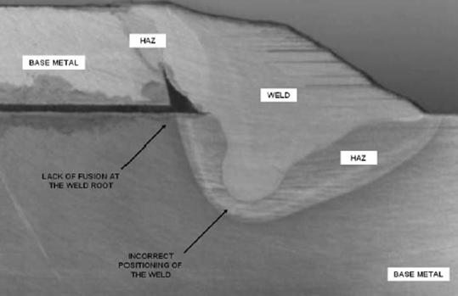
Penetration Nugget Shape

Slide 11
Over Weld Fillet Weld Size Costs
Specified
Fillet Weld Volume
Leg Size (lb/ft) *
Actual
Fillet Weld Volume Leg Size (lb/ft) *
Over Weld
%
1/8 0.027 3/16 0.060
122%
3/16 0.060
1/4 0.1065
77.5%
1/4 0.1065 5/16 0.166
56%
*Fillet leg size is for Theoretical Weld Volume per foot
Unlocking the Hidden Cost of Welding
Notes:
10

Slide 12
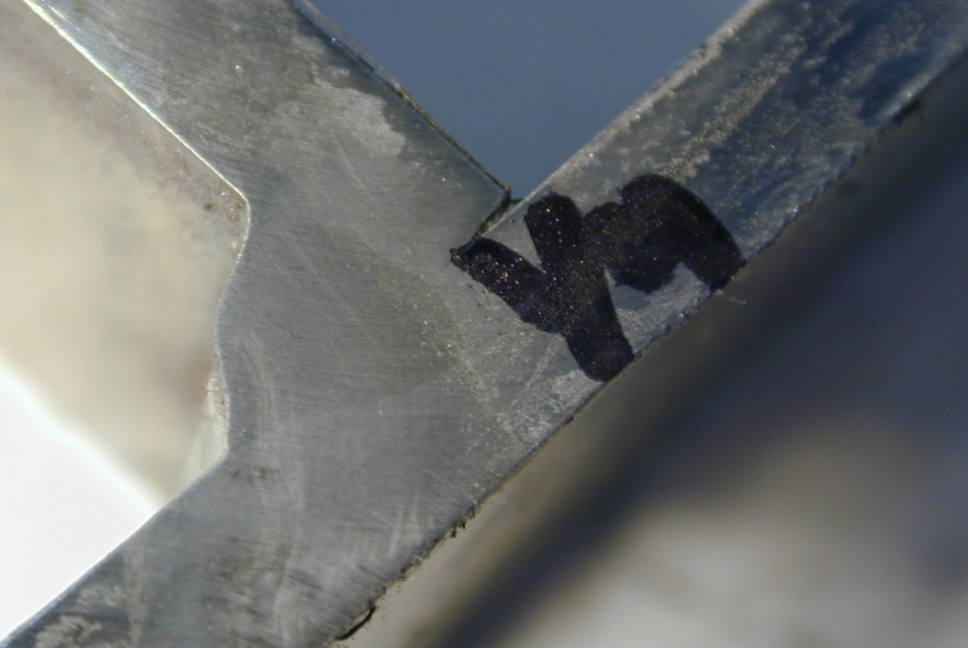
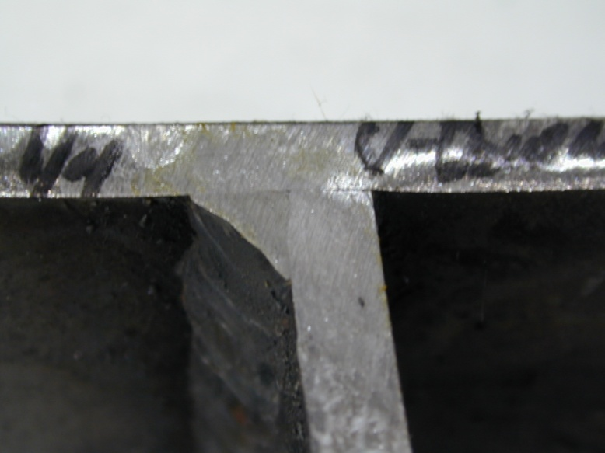
Why Would You Over Weld This Joint?
Unlocking the Hidden Cost of Welding

Slide 13
Weld Size: Where Have the Welders Gone?
GMAW - “MIG”
10 welders
27.00 $ / hr
8.8 lb / hr
3/16
1/4
Travel Speed – 25.2 ipm
Cost: $332,849/yr
77.5%
Travel Speed – 14.0 ipm
Cost: $597,727/yr
$264,878/yr or 9,033 hour 4 less people
Unlocking the Hidden Cost of Welding
Notes:
12

Slide 14
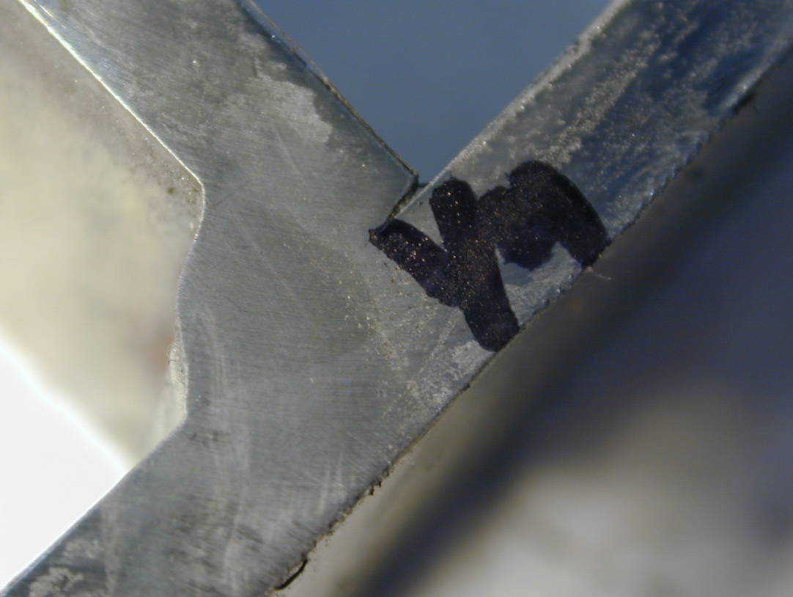

Spray Transfer
Process / Gas Selection (One Reason for Over Weld)
Lack of Fusion
Short Circuit Transfer
Unlocking the Hidden Cost of Welding

Slide 15
Arc On Time: $ / yr. Savings
GMAW - “MIG”
10 welders
27.00 $/hr
1/4” Fillet – 8.8 lb / hr
3 min
per hr
Avg. Arc On Time - 15%
Avg. Arc On Time - 20%
Travel Speed - 14 ipm
Cost – 597,727.74 $ / yr.
Travel Speed - 14 ipm
Cost – 460,298.31 $ / yr.
$137,429.43/yr or 5,090 hours 2 less people
Unlocking the Hidden Cost of Welding
Notes:
14

Slide 16
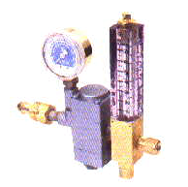
Typical Gas Mix / Volume Issues
A5.32: +/- 10% Minor Component
Average measured 40% variance
Cause for weld Discontinuities
Efficiencies control
Flow control
Surge
Leaks
Weld Discontinuities
Unlocking the Hidden Cost of Welding
Notes:
15

Slide 17
Do You Have Gas?
1 leak...
60 ft³ / hr
0.0375 $ / ft³
24 hr x 60 ft³ x 0.0375 $ x 365 day
day hr ft³ yr
= $ 19,710.00
yr
Unlocking the Hidden Cost of Welding
Notes:
16

Slide 18
Airgas Advanced Fab Fundamental Beliefs
61 Certified Welding Supervisors focused on Weld Economics
Local expertise, using a proven measuring methodology
Quality leads to lower costs
Most defects and rework are caused by the process
The process is never optimized and can always be improved
You can’t manage, what you don’t measure
Call 800-548-0909 for more information
Unlocking the Hidden Cost of Welding

Slide 19
A Quote from Henry Ford
“Whether you think you can, or think you can’t…You’re right.”
Unlocking the Hidden Cost of Welding
Notes:
Ask Are you going to do this work with us?

Slide 20

Learn By Doing…
“Try? There is no try.
There is only do or not do.”
― Yoda, Legendary Sensei
Unlocking the Hidden Cost of Welding
Notes:
Ask Are you going to do this work with us?

